Slide 1



Chicago Crime Data Analysis
S Shabin
DS November -23

Slide 2
About
Chicago is the most populous city in the U.S. state of Illinois. It is the third-most populous city in the United States .
Chicago saw a major rise in crime starting in the late 1960s.The city's overall crime rate, especially the violent crime rate, is higher than the US average.
The Chicago Police Department (CPD) is the primary law enforcement agency of the city of Chicago under the jurisdiction of the Chicago City Council. As of 2022 CPD had 11,710 sworn officers on duty, and over 948 other employees.

Slide 3
Problem Statement
A year ago in Chicago, the high incidence of crime prompted the government to take decisive action by launching an operation with top-performing police officers. Now, as a year has passed since this decision, the government seeks to evaluate the reduction in crime cases and the advantages gained from this new operation.

Slide 4
Objective
Evaluation of case solving time
Crime rate evaluation in localities to identify crime prone areas
Find proper measures to decrease crime rate

Slide 5
Crimes Recorded
Key Metrics
Domestic cases
89709
18000
Crimes Arrested
Domestic Cases Arrested
11157
2276
Average Case Solving Time
Domestic Arrest Rate
Arrest Rate
12.64%
9.01
12.44%

Slide 6
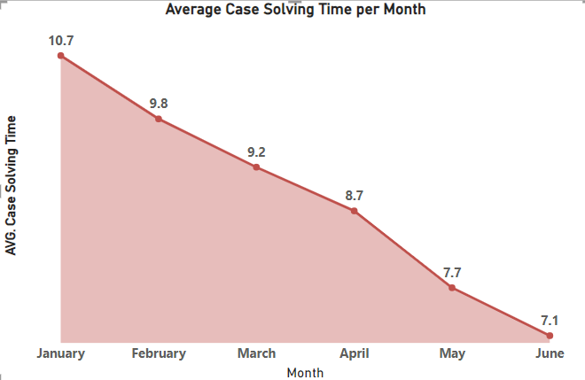
Case Solving Time Analysis
Average Case Solving Time
9.01
The case solving time has shown significant reduction over the six months of time when police operation was implemented.
In January, the case solving time was 10.7 which came down to 7.1 in June.

Slide 7
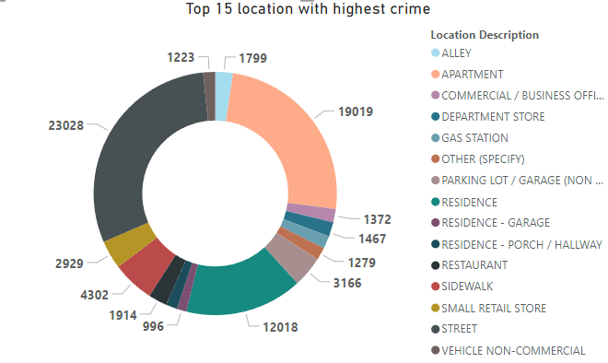
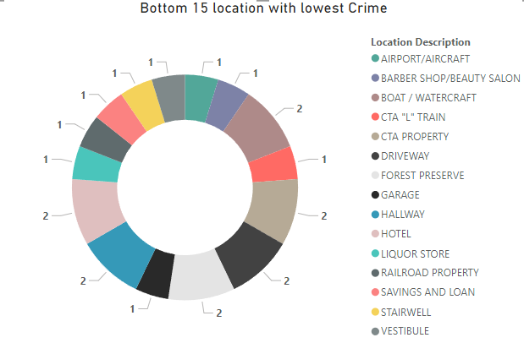
Crime Analysis Based On Locality
From the adjacent pie chart, the top 15 locations with the highest recorded crimes are visible.
Apartment has the highest crimes recorded which is 19019.
The major chunk of crimes are recorded on 3 locality mainly Apartment,Street,Residence.
From the adjacent chart, the bottom 15 locations with the least recorded crimes are visible.
The lowest crime recorded in a locality is 1 .

Slide 8
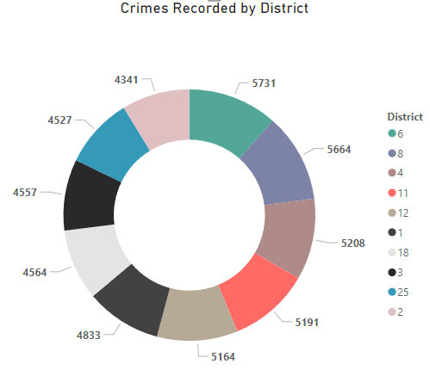
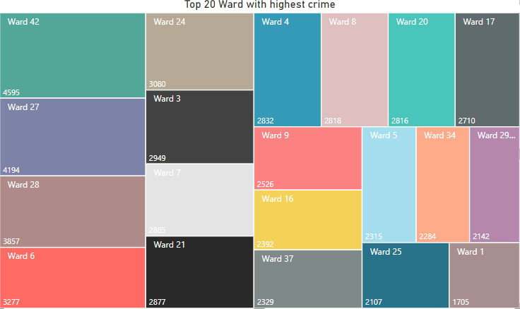
Crime Analysis Based On Location
Chicago is divided into 25 districts .
The top 10 districts with highest number of recorded crimes are shown in the pie chart.
District 6 has the highest recorded crime of 5731 cases.
Chicago is divided into 50 wards .
Top 20 wards with the highest number of crimes recorded are shown in the adjacent chart.
Ward no 42 has the highest recorded crime of 4595 cases.

Slide 9
1
Fixing Distressed Spaces
2
Focused deterrence policing
Suggested Measures To Improve Crime Statistics
3
Help ex-offenders find secure living-wage employment
4
Scientific Supports for Law Enforcement
5
Shorten the Reach of the Criminal Justice System
6
Fund Community-Based Violence Interruption

Slide 10
Report

Slide 11
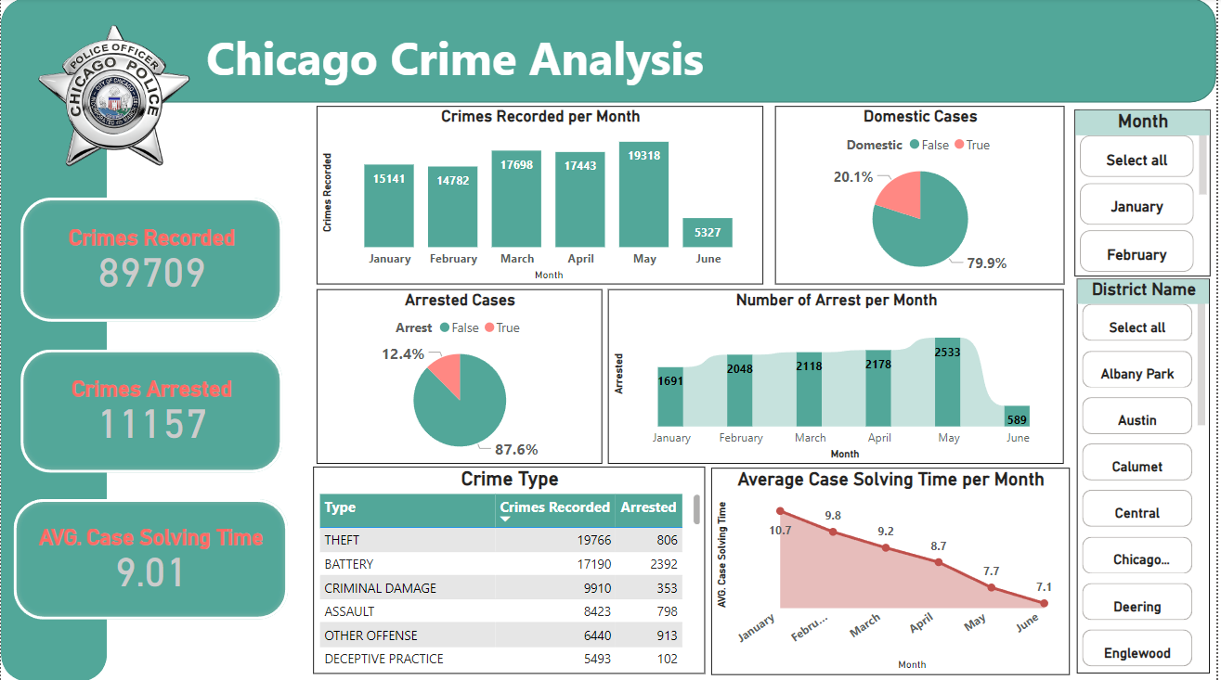

Slide 12
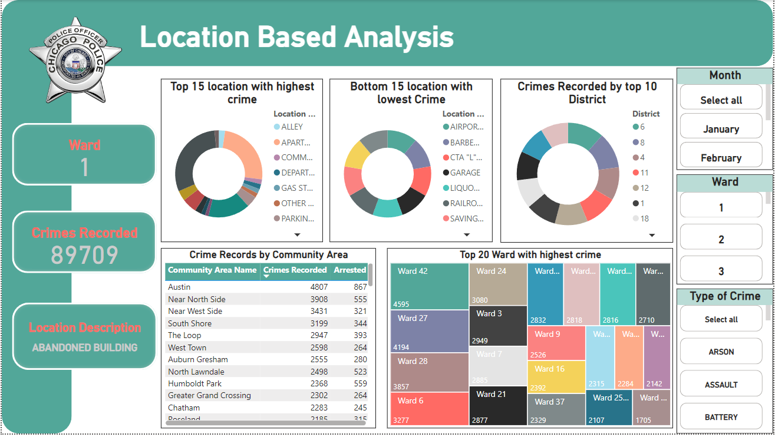

Slide 13
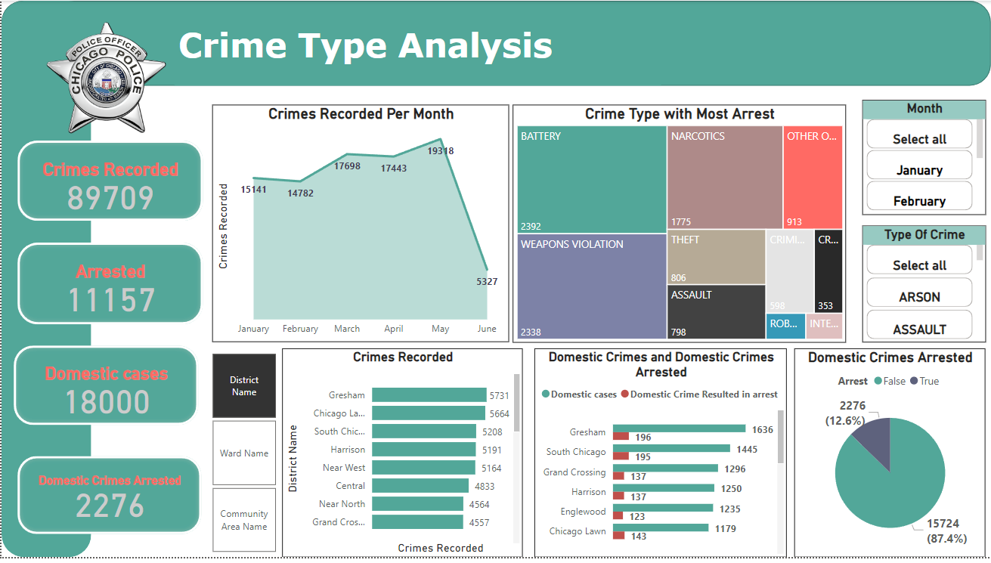

Slide 14
Thank You

